Slide 1
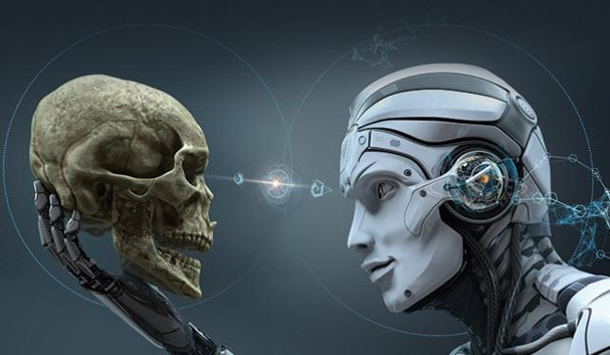
Artificial Intelligence
An Introduction
CS 650 – Artificial Intelligence
Mr. Nardi

Slide 2
Progress…
“Progress has never been a bargain. You have to pay for it. Sometimes I think there’s a man who sits behind a counter and says, ‘All right, you can have a telephone but you lose privacy and the charm of distance. You may conquer the air but the birds will lose their wonder and the clouds will smell of gasoline’…
…Jerome Lawrence, author, “Inherit the Wind”

Slide 3
Oxymoron…
A Combination of Contradictory or Incongruous Words…
Something That Is Made Up of Contradictory or Incongruous Elements…

Slide 4
Oxymoron…
A Combination of Contradictory or Incongruous Words…
Something That Is Made Up of Contradictory or Incongruous Elements…
For Example:
Jumbo Shrimp…

Slide 5
Oxymoron…
A Combination of Contradictory or Incongruous Words…
Something That Is Made Up of Contradictory or Incongruous Elements…
For Example:
Jumbo Shrimp…
Clearly Confused…

Slide 6
Oxymoron…
A Combination of Contradictory or Incongruous Words…
Something That Is Made Up of Contradictory or Incongruous Elements…
For Example:
Jumbo Shrimp…
Clearly Confused…
Deafening Silence…

Slide 7
Oxymoron…
A Combination of Contradictory or Incongruous Words…
Something That Is Made Up of Contradictory or Incongruous Elements…
For Example:
Jumbo Shrimp…
Clearly Confused…
Deafening Silence…
Open Secret…

Slide 8
Oxymoron…
A Combination of Contradictory or Incongruous Words…
Something That Is Made Up of Contradictory or Incongruous Elements…
For Example:
Jumbo Shrimp…
Clearly Confused…
Deafening Silence…
Open Secret…
Artificial Intelligence…

Slide 9
Oxymoron…
A Combination of Contradictory or Incongruous Words…
Something That Is Made Up of Contradictory or Incongruous Elements…
For Example:
Jumbo Shrimp…
Clearly Confused…
Deafening Silence…
Open Secret…
Artificial Intelligence…
ARTIFICIAL INTELLIGENCE?!...

Slide 10
Artificial Intelligence…
By Definition…
Artificial : Not Real…Not Natural…Made or Produced By Human Beings Rather Than Occurring Naturally…Typically as a COPY of Something Natural…
Intelligence : the Ability to Deal With New or Trying Situations…to Learn or Understand…the Ability to Apply Knowledge to Manipulate One's Environment or to Think Abstractly as Measured By Objective Criteria (Such As Tests)…
How Do I Copy Something That Has Not Happened Yet?!...

Slide 11
AI Through the Decades…
Forbidden Planet (1956)
https://www.youtube.com/watch?v=3GSd92zgqAs
The Jetsons (1962)
https://www.youtube.com/watch?v=tTq6Tofmo7E
Lost in Space (1965)
https://www.youtube.com/watch?v=GydbuH4C8QA
2001: A Space Odyssey (1968)
https://www.youtube.com/watch?v=HwBmPiOmEGQ
Star Trek: The Next Generation (1987)
https://www.youtube.com/watch?v=g4AEBiyn8Rs

Slide 12
History of Artificial Intelligence…
https://www.youtube.com/watch?v=-qnMLjxJZm0

Slide 13
History of Artificial Intelligence – Part 1…
1943 – The Turing Test: Alan Turing invented the “Turing Test”…this set the standard for an intelligent machine…a computer that could fool someone into thinking they were talking to a real person…
1950 – “I, Robot”: a collection of short stories by science fiction writer Isaac Asimov was published…
1956 – Artificial Intelligence: John McCarthy coined the term “artificial intelligence”…a “top-down approach” was dominant at the time…pre-programming a computer with rules that govern human behavior…
1968 – “2001: A Space Odyssey”: Marvin Minsky, the founder of the AI Laboratory at MIT, advised Stanley Kubrick on the film “2001: A Space Odyssey” which featuring an intelligent computer, HAL 9000…
1969 – Shakey the Robot: the first general purpose mobile robot built…was able to make decisions about its own actions by “reasoning” about its surroundings…
1973 – “AI Winter”: funding in the AI industry was drastically cut as millions had been spent with little to show…
1981 – Narrow AI: instead of trying to create a general intelligence, research shifted toward creating “expert systems” which focused on much narrower tasks…DEC made these systems a commercial success (i.e., calculators, bar code readers), ending the “AI Winter”…

Slide 14
History of Artificial Intelligence – Part 2…
1990 – Bottom-Up Approach: Rodney Brooks spearheaded the “bottom up approach”, aimed at developing neural networks that simulated brain cells and learned new behaviors…
1997 – Deep Blue: IBM supercomputer Deep Blue faced world chess champion Garry Kasparov…Deep Blue won game 1 of a 6-game match against Kasparov…however, Kasparov defeated Deep Blue 4–2…
1997 – Deep Blue Part 2: a heavily upgraded Deep Blue again played Kasparov…Deep Blue became the first computer system to defeat a reigning chess world champion, winning the rematch 3½–2½…Kasparov accused IBM of cheating and demanded a rematch…IBM refused and dismantled Deep Blue…
2002 – Roomba: iRobot created the first commercially successful robot for the home…an autonomous vacuum cleaner called Roomba…
2005 – BigDog: the US Military started investing in autonomous robots…BigDog, made by Boston Dynamics was one of the first… https://www.youtube.com/watch?v=W1czBcnX1Ww

Slide 15
History of Artificial Intelligence – Part 3…
2008 – Google App: Google launched a speech recognition app on the new iPhone…it was the first step towards Apple’s Siri, Google Assistant, Amazon Alexa, and Microsoft Cortana…
2010 – Dancing Nao Robots: at Shanghai’s 2010 World Expo, 20 NAO robots danced in perfect harmony for 8 minutes… https://www.youtube.com/watch?v=vgEFC8Eb6i4
2011 – Watson: IBM’s Watson took on the human brain on Jeopardy and won against the two best performers of all time on the show… https://www.youtube.com/watch?v=P18EdAKuC1U
2014 – Eugene Goostman: 64 years after the test was conceived, a chatbot called Eugene Goostman passed the Turing Test…additionally, Google invested a billion dollars in driverless cars, and Skype launched real-time voice translation…

Slide 16
Examples of AI You Use Every Day…
Virtual Personal Assistants
Alexa, Siri, Google Now, and Cortana Are All Intelligent Digital Personal Assistants…
They Help Find Useful Information When You Ask For It Using Your Voice…
They Collect Information on Your Requests and Use That Information to Better Recognize Your Speech and Serve You Results That Are Tailored to Your Preferences…
“Where’s the Nearest Starbucks?”…“What’s On My Schedule Today?”…“Remind Me To Do My AI Homework At Eight O’Clock”…
Video Games
Nuff Said!...

Slide 17
Examples of AI You Use Every Day…
Smart Cars…
https://youtu.be/uCezICQNgJU
Purchase Prediction…
Large Retailers Like Target and Amazon Stand to Make a Lot of Money If They Can Anticipate Your Needs...
When You Go to the Store, You’re Often Given a Number of Coupons Selected By a Predictive Analytics Algorithm…
Controversial Use of AI…Makes Some People Nervous About Potential Privacy Violations…
Fraud Detection…
AI Is The Technology Deployed To Monitor For Fraudulent Transactions…
Many Banks Send Communications If They Think Fraud May Have Been Committed…
Computers Are Given Very Large Sample Of Fraudulent And Non-fraudulent Purchases And Learn To Look For Signs That A Transaction Falls Into One Category Or Another…

Slide 18
Examples of AI You Use Every Day…
Online Customer Support
In Many Cases, You’re Talking to a Chat Bot Able to Extract Knowledge From a Website and Present It to Customers When They Ask For It…
Chat Bots Need to Understand Natural Language…
Movie, Music, News Recommendations…
Based on Choices and Interests You’ve Expressed in the Past…
Monitors Choices You Make and Inserts Them Into a Learning Algorithm to Make Recommendations You’re Likely Interested In…
https://youtu.be/PgjjAyv567Q

Slide 19
Other Examples of AI Today…
Drive Safely Along a Curving Mountain Road…
Buy a Week’s Worth of Groceries on the Web…
Play a Decent Game of Bridge…
Give Competent Legal Advice in a Specialized Area of Law…
Translate Spoken English Into Another Language in Real Time…
Converse Successfully With Another Person for an Hour…
Perform a Complex Surgical Operation…

Slide 20
How Do YOU Think?...
Thinking Typically Follows a Process:
Set a Goal Based On What You Need or Want…
Assess Currently Known Information in Support of the Goal…
Gather Additional Information That Could Further Support the Goal…
Manipulate the NEW Data So That It Is Consistent With EXISTING Information…
Define the Relationship Between Existing and New Information…
Determine Whether the Goal is Achieved…
Modify the Goal in Light of the New Data and Its Effect on the Probability of Success…
Repeat Steps 2 Through 7 As Needed Until the Goal is Achieved (Found True) or the Possibilities For Achieving It Are Exhausted (Found False)…

Slide 21
According to Technopedia…
Artificial Intelligence (AI) Is An Area Of Computer Science That Emphasizes the Creation of Intelligent Machines That Work and React Like Humans…
Some of the Activities Computers With Artificial Intelligence Are Designed For Include:
Speech Recognition…
Learning…
Planning…
Problem Solving…

Slide 22
7 Categories of Intelligence…
Visual – Spatial : Physical Environment…
Bodily – Kinesthetic : Body Movements…
Creative : New Patterns of Thought Resulting in Unique Output…
Interpersonal : Interacting With Others…
Intrapersonal : Looking Inward…
Linguistic : Working With Words…
Logical – Mathematical : Calculating a Result…the Focus of All Computer Intelligence That a Computer Performs…

Slide 23
Categories of Intelligence: Visual-Spatial…
Simulation Potential | Human Tools | Description
Moderate | Models, Graphics, Charts, Photographs, Drawings, 3-D Modeling, Video, Television, And Multimedia | Physical Environment Intelligence Used By People Like Sailors And Architects (Among Many Others)…To Move At All, Humans Need To Understand Their Physical Environment…That Is, Its Dimensions And Characteristics… Every Robot Or Portable Computer Intelligence Requires This Capability, But The Capability Is Often Difficult To Simulate (As With Self-Driving Cars) Or Less Than Accurate (As With Vacuums That Rely As Much On Bumping As They Do Moving Intelligently)…

Slide 24
Categories of Intelligence: Bodily-Kinesthetic…
Simulation Potential | Human Tools | Description
Moderate To High | Specialized Equipment And Real Objects | Body Movements, Such As Those Used By A Surgeon Or A Dancer, Require Precision And Body Awareness…Robots Commonly Use This Kind Of Intelligence To Perform Repetitive Tasks, Often With Higher Precision Than Humans, But Sometimes With Less Grace… It's Essential To Differentiate Between Human Augmentation, Such As A Surgical Device That Provides A Surgeon With Enhanced Physical Ability, And True Independent Movement…The Former Is Simply A Demonstration Of Mathematical Ability In That It Depends On The Surgeon For Input…

Slide 25
Categories of Intelligence: Creative…
Simulation Potential | Human Tools | Description
None | Artistic Output, New Patterns Of Thought, Inventions, New Kinds Of Musical Composition | Creativity Is The Act Of Developing A New Pattern Of Thought That Results In Unique Output In The Form Of Art, Music, And Writing…A Truly New Kind Of Product Is The Result Of Creativity… AI Can Simulate Existing Patterns Of Thought And Even Combine Them To Create What Appears To Be A Unique Presentation But Is Really Just A Mathematically Based Version Of An Existing Pattern…In Order To Create, An AI Would Need To Possess Self-Awareness, Which Would Require Intrapersonal Intelligence…

Slide 26
Categories of Intelligence: Interpersonal…
Simulation Potential | Human Tools | Description
Low To Moderate | Telephone, Audio Conferencing, Video Conferencing, Writing, Computer Conferencing, Email | Interacting With Others Occurs At Several Levels…The Goal Of This Form Of Intelligence Is To Obtain, Exchange, Give, And Manipulate Information Based On The Experiences Of Others… Computers Can Answer Basic Questions Because Of Keyword Input, Not Because They Understand The Question…The Intelligence Occurs While Obtaining Information, Locating Suitable Keywords, And Then Giving Information Based On Those Keywords… Cross-Referencing Terms In A Lookup Table And Then Acting On The Instructions Provided By The Table Demonstrates Logical Intelligence, Not Interpersonal Intelligence…

Slide 27
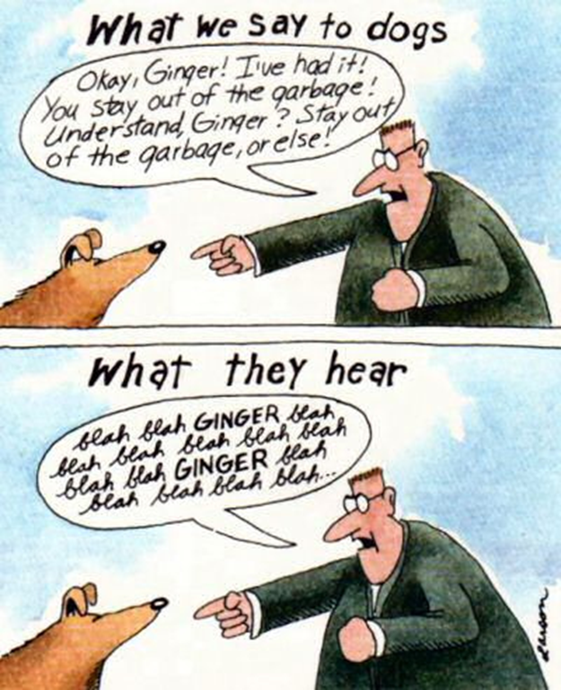
Categories of Intelligence: Interpersonal…
Computers Can Answer Basic Questions Because Of Keyword Input, Not Because They Understand The Question… The Intelligence Occurs While Obtaining Information, Locating Suitable Keywords, And Then Giving Information Based On Those Keywords… Cross-Referencing Terms In A Lookup Table And Then Acting On The Instructions Provided By The Table Demonstrates Logical Intelligence, Not Interpersonal Intelligence…

Slide 28
Categories of Intelligence: Intrapersonal…
Simulation Potential | Human Tools | Description
None | Books, Creative Materials, Diaries, Privacy, And Time | Looking Inward To Understand One's Own Interests And Then Setting Goals Based On Those Interests Is Currently A Human-only Kind Of Intelligence… As Machines, Computers Have No Desires, Interests, Wants, Or Creative Abilities…An AI Processes Numeric Input Using A Set Of Algorithms And Provides An Output…It Isn't Aware Of Anything That It Does, Nor Does It Understand Anything That It Does…

Slide 29
Categories of Intelligence: Linguistic…
Simulation Potential | Human Tools | Description
Low | Games, Multimedia, Books, Voice Recorders, And Spoken Words | Working With Words Is An Essential Tool For Communication…Spoken And Written Information Exchange Is Far Faster Than Any Other Form…This Intelligence Includes Understanding Spoken And Written Input, Managing The Input To Develop An Answer, And Providing An Understandable Answer As Output…In Many Cases, Computers Can Barely Parse Input Into Keywords, Can't Actually Understand The Request At All, And Output Responses That May Not Be Understandable At All…In Humans, Spoken And Written Linguistic Intelligence Come From Different Areas Of The Brain Which Means That Even With Humans, Someone Who Has High Written Linguistic Intelligence May Not Have Similarly High Spoken Linguistic Intelligence…

Slide 30
Categories of Intelligence: Logical-Mathematical…
Simulation Potential | Human Tools | Description
High | Logic Games, Investigations, Mysteries, And Brain Teasers | Calculating A Result, Performing Comparisons, Exploring Patterns, And Considering Relationships Are All Areas In Which Computers Currently Excel… When You See A Computer Beat A Human On A Game Show, This Is The Only Form Of Intelligence That You're Actually Seeing, Out Of Seven…Yes, You Might See Small Bits Of Other Kinds Of Intelligence, But This Is The Focus…Basing An Assessment Of Human Versus Computer Intelligence On Just One Area Isn't A Good Idea…

Slide 31
So What ISN’T AI?...
ARTIFICIAL Intelligence Has Nothing to Do with HUMAN Intelligence…
So While Some AI Is Modeled To SIMULATE Human Intelligence, That Is What It Is: A Simulation…
Human Thought Involves a Blend of Goal Seeking, Data Processing Used To Achieve That Goal, And Data Acquisition Used To Better Understand The Goal…
AI Relies On Algorithms To Achieve A Result That May Or May Not Have Anything To Do With Human Goals Or Methods Of Achieving Those Goals…
HUMAN Thought Process Is NOT RATIONAL Thought Process…

Slide 32
Human Versus Rational Thought Processes…
Human Thought Processes Differ From Rational Thought Processes In Their Outcome…
A Process Is Rational If It Always Does The Right Thing Based On The Current Information, Given An Ideal Performance Measure…
Rational Processes Go By “The Book”…And Assumes That “The Book” Is Actually Correct!...
Human Thought Processes Involve Instinct, Intuition, And Other Variables That Don't Necessarily Reflect “The Book” And May Not Even Consider The Existing Data…

Slide 33
For Example – Driving a Car…
Rational: Everyone Always Follow the Laws PRECISELY…
Human: Everyone Always Follow the Laws PRECISELY…Sort Of…
All Drivers Do NOT Follow the Laws Precisely….
A Self-Driving Car Needs to Act HUMANLY…NOT Rationally…
WAZE Anyone?!...

Slide 34
Tic-Tac-Toe Anyone?...
def computer_move(board, computer, human):
"""Make computer move."""
# make a copy to work with since function will be changing list
board = board[:]
# the best positions to have, in order
BEST_MOVES = (4, 0, 2, 6, 8, 1, 3, 5, 7)
print("I shall take square number", end=" ")
# if computer can win, take that move
for move in legal_moves(board):
board[move] = computer
if winner(board) == computer:
print(move)
return move
# done checking this move, undo it
board[move] = EMPTY
# if human can win, block that move
for move in legal_moves(board):
board[move] = human
if winner(board) == human:
print(move)
return move
# done checking this move, undo it
board[move] = EMPTY
# since no one can win on next move, pick best open square
for move in BEST_MOVES:
if move in legal_moves(board):
print(move)
return move

Slide 35
Logic of Relationships…
dog (fido). FACT
cat (felix). FACT
animal(X) :- dog(X). RULE: “X” Is an Animal If “X” Is a Dog…
?- animal(fido).
true.
?-animal(felix)
false.

Slide 36
Rational Agents...
An Agent Is An Entity That Perceives And Acts…
This Course Is Really About Rational Agents…
An Agent Is A Function That Converts History To Actions…
For Any Given Class Of Environments And Tasks, We Seek The Agent (Or Class Of Agents) With The Best Performance…

Slide 37
So What Is AI?…
Categorize AI Systems Four Ways:
Systems That THINK Like Humans…
Systems That Think RATIONALLY…
Systems That ACT Like Humans…
Systems That Act RATIONALLY…

Slide 38
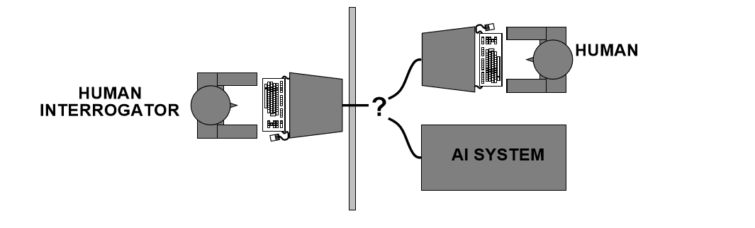
ACTING Humanly: The Turing Test...
Turing (1950) “Computing Machinery And Intelligence”…
“Can Machines Think?”…
“Can Machines Behave Intelligently?”…
Operational Test For Intelligent Behavior: The Imitation Game…

Slide 39
ACTING Humanly: After The Turing Test...
The Turing Test Is Best Reflected When There Is No Physical Contact And You Cannot Tell The Difference Between The Computer And A Human…
The Newer, Total Turing Test Does Include Physical Contact In The Form Of “Perceptual Ability Interrogation”, Meaning The Computer Must Employ Both Computer Vision And Robotics To Succeed…
Modern Techniques Include The Idea Of Achieving The Goal Rather Than Mimicking Humans Completely…More of an “Object Oriented” Approach…
For Example:
The Wright Brothers Didn't Succeed In Creating An Airplane By Precisely Copying The Flight Of Birds…Rather, The Birds Provided Ideas That Led To Aerodynamics That Eventually Led To Human Flight…
The Goal Is To Fly…Both Birds And Humans Achieve This Goal, But They Use Different Approaches…

Slide 40
THINKING Humanly: Cognitive Science...
Performs Tasks That Require Intelligence (Not Rote Procedures) From A Human To Succeed…
To Determine Whether A Program Thinks Like A Human, Need Some Cognitive Method Of Determining How Humans Think…
Introspection: Detecting And Documenting Techniques Used To Achieve Goals By Monitoring One's Own Thought Processes…
Psychological Testing: Observing A Person's Behavior…Adding It To A Database Of Similar Behaviors From Other Persons Given A Similar Set Of Circumstances, Goals, Resources, And Environmental Conditions…
Brain Imaging: Monitoring Brain Activity Directly Through Various Mechanical Means…
After Creating A Model, You Can Write A Program That SIMULATES The Model….
Given The Amount Of Variability Among Human Thought Processes And The Difficulty Of Accurately Representing These Thought Processes As Part Of A Program, The Results Are Experimental At Best…
This Category Of Thinking Humanly Is Often Used In Psychology And Other Fields In Which Modeling The Human Thought Process To Create Realistic Simulations Is Essential…

Slide 41
Thinking RATIONALLY : Laws of Thought...
Normative (Or Prescriptive) Rather Than Descriptive…
Creation of Guidelines That Describe TYPICAL Human Behavior…
Creation of Guidelines As To How To Interact With An Environment Based On The Data At Hand…
Goal Of This Approach Is To Solve Problems LOGICALLY, When Possible….However, Not All Intelligent Behavior is Mediated by Logical Deliberation…
This Approach Would Enable The Creation Of A Baseline Technique For Solving A Problem, Which Would Then Be Modified To Actually Solve The Problem…That Is, Solving A Problem In Principle Is Often Different From Solving It In Practice...

Slide 42
Acting RATIONALLY : Doing the Right Thing...
The Right Thing: That Which Is Expected To Maximize Goal Achievement, Given The Available Information…
Doesn’t Necessarily Involve Thinking (e.g., Blinking Reﬂex)…But Thinking SHOULD Be In The Service Of Rational Action…
Rational Acts Depend On a Solution in PRINCIPLE Which May Not Prove Useful in Practice…
Aristotle (Nicomachean Ethics): Every Art And Every Inquiry, And Similarly Every Action And Pursuit, Is Thought To Aim At Some Good…

Slide 43
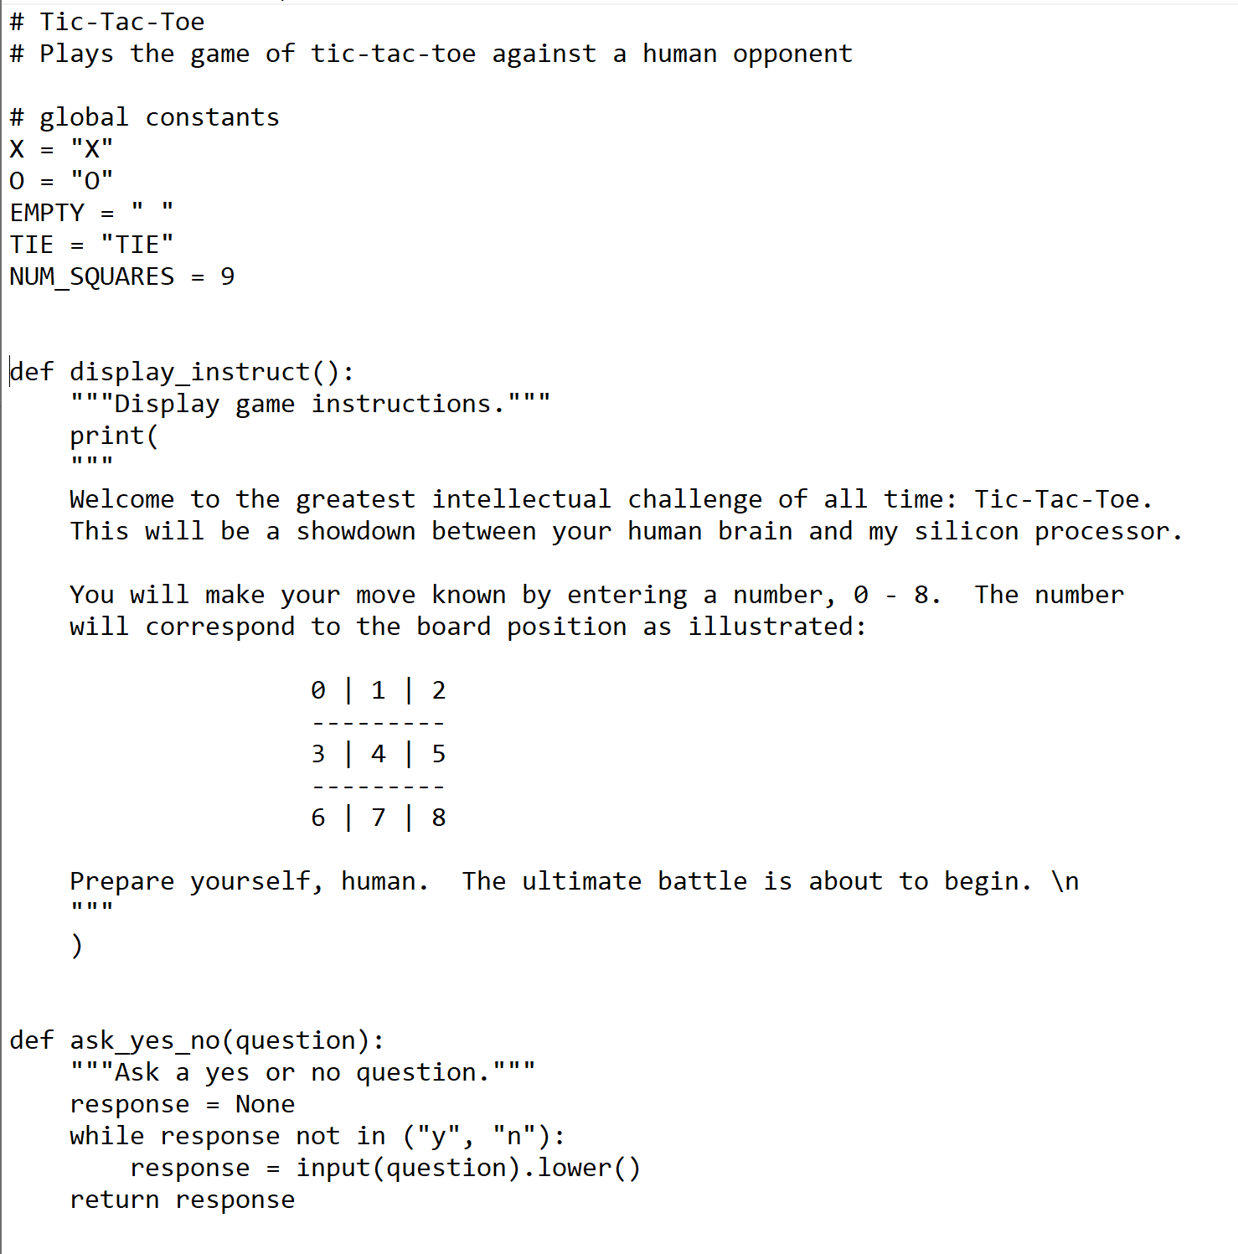
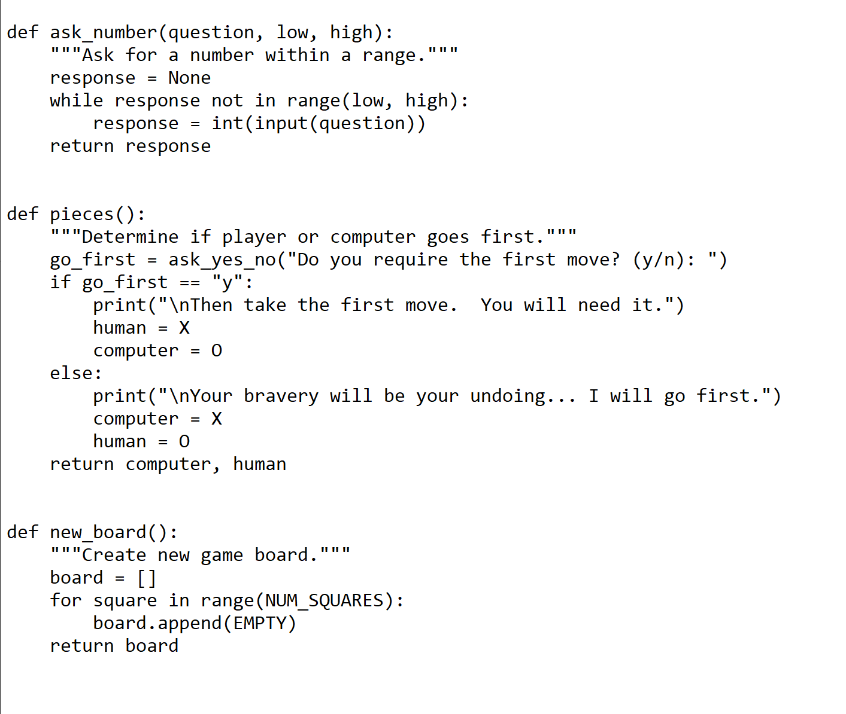
Let’s Take Another Look at Tic-Tac-Toe…

Slide 44
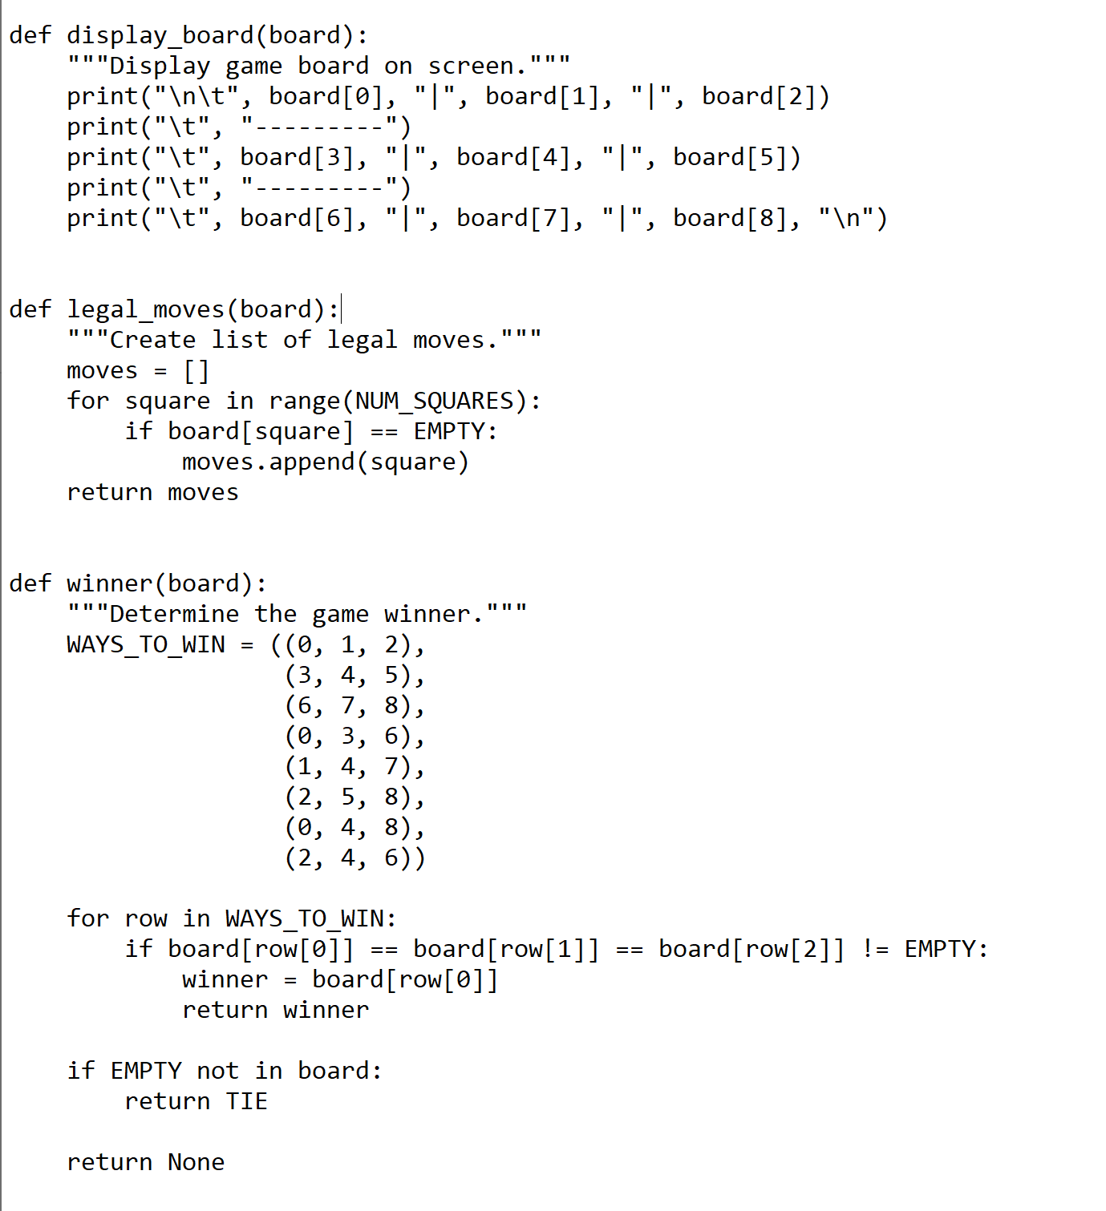
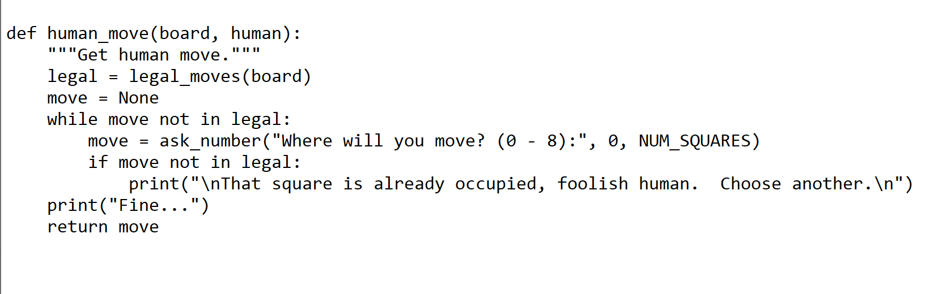
Tic-Tac-Toe Part 2…

Slide 45
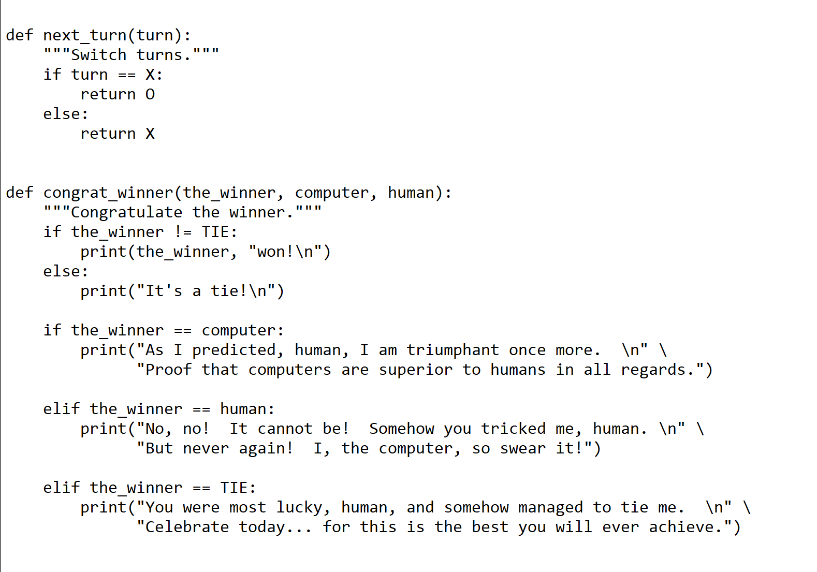
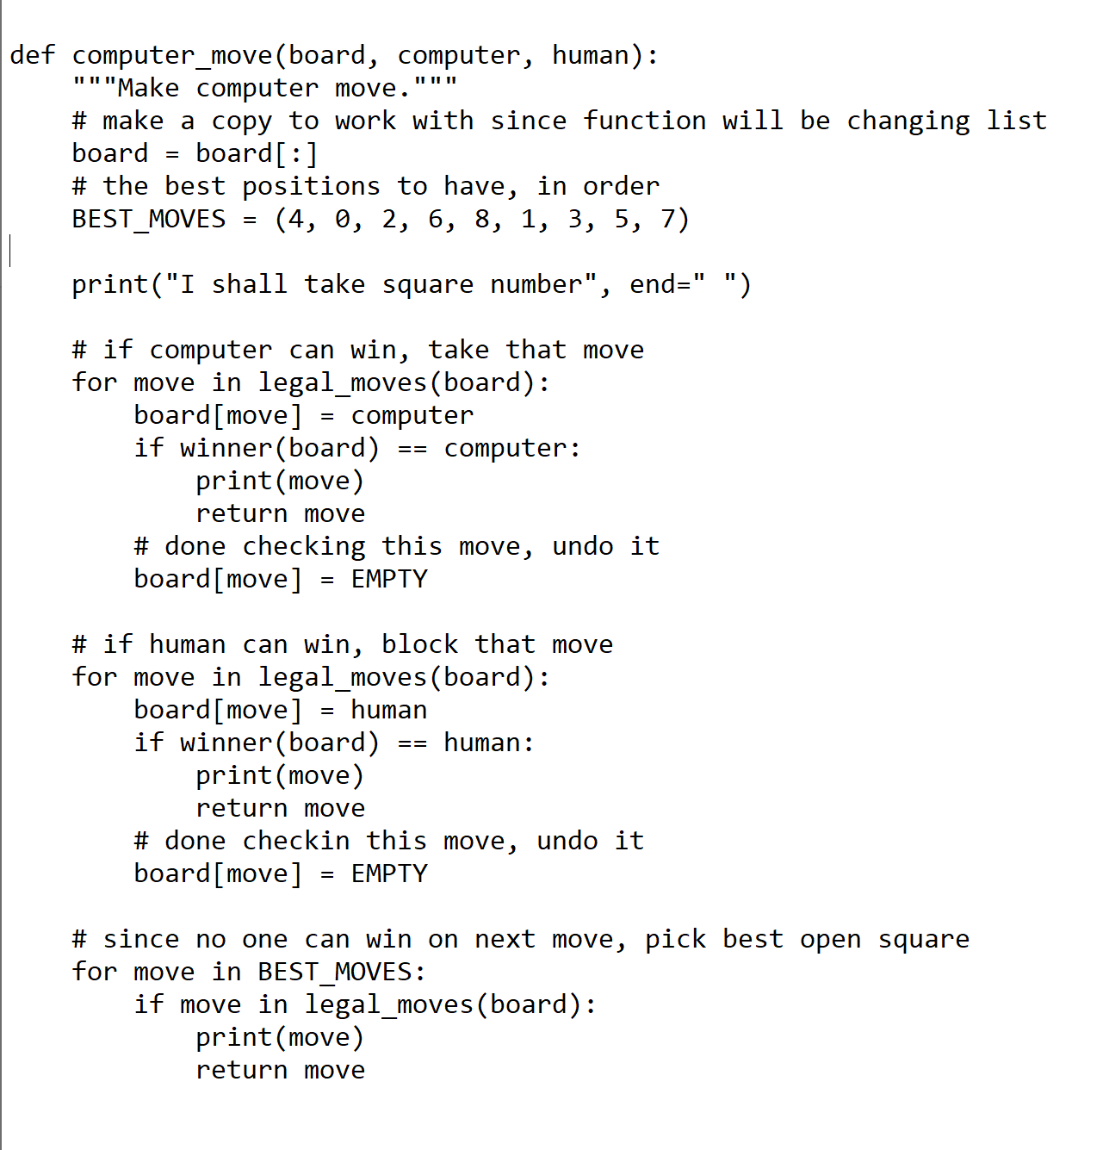
Tic-Tac-Toe Part 3…

Slide 46
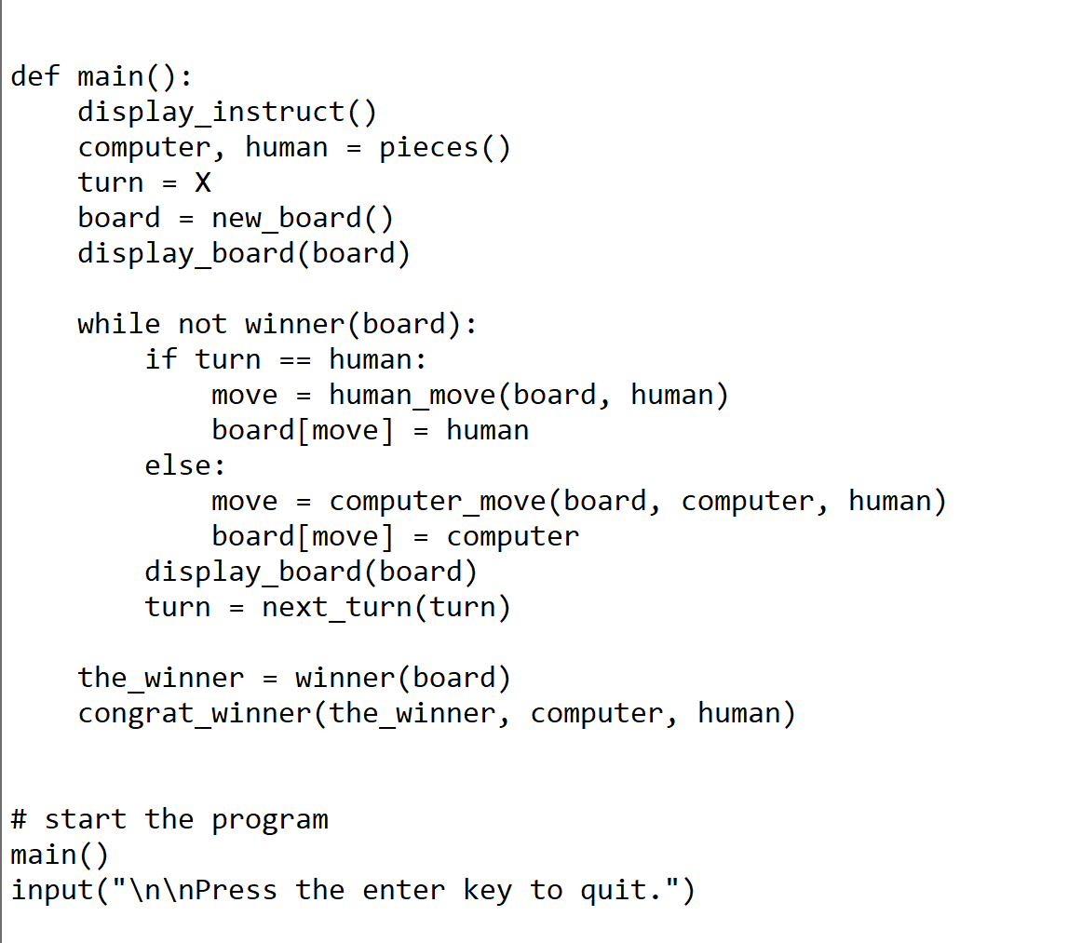
Tic-Tac-Toe Part 4…

Slide 47
We Need a Break!...
Hey I Know…Let’s Play a Game!...

Slide 48


Let’s Play a Game!...
We Have Talked A Lot About the Philosophy of Artificial Intelligence…
I Am Sure EVERYONE Has Been Exposed to AI in One Form or Another…
For Your First Assignment:
Select Your Favorite Video Game or AI “Experience”
Play It (Visit It) For an Hour or So…
Tell Me How the Video Game or “Experience” Represents the Four Categories of AI (i.e., Act Humanly, Think Humanly, Think Rationally, Act Rationally)…
Tell Me How the Video Game or “Experience” Represents the Seven Kinds of Intelligence (i.e., Visual – Spatial, Bodily – Kinesthetic, Creative, Interpersonal, Intrapersonal, Linguistic, Logical – Mathematical)…
If You Think the Video Game or “Experience” Does NOT Represent Any of These Eleven Items, Tell Me Why You Think That and Tell Me How You Would Change the Game or “Experience” So That It Does…
BONUS: Show a Demo to the Class…
You May Do This Assignment Either Individually OR In Pairs (Meaning TWO)…

Slide 49
Questions?...

